Slide 1
Planning under Uncertainty with Markov Decision Processes:
Lecture I
Craig Boutilier
Department of Computer Science
University of Toronto

Slide 2
Planning in Artificial Intelligence
Planning has a long history in AI
  strong interaction with logic-based knowledge representation and reasoning schemes
Basic planning problem:
  Given: start state, goal conditions, actions
  Find: sequence of actions leading from start to goal
  Typically: states correspond to possible worlds; actions and goals specified using a logical formalism (e.g., STRIPS, situation calculus, temporal logic, etc.)
Specialized algorithms, planning as theorem proving, etc. often exploit logical structure of problem is various ways to solve effectively

Slide 3







A Planning Problem

Slide 4
Difficulties for the Classical Model
Uncertainty
  in action effects
  in knowledge of system state
  a “sequence of actions that guarantees goal achievement” often does not exist
Multiple, competing objectives
Ongoing processes
  lack of well-defined termination criteria

Slide 5
Some Specific Difficulties
Maintenance goals: “keep lab tidy”
  goal is never achieved once and for all
  can’t be treated as a safety constraint
Preempted/Multiple goals: “coffee vs. mail”
  must address tradeoffs: priorities, risk, etc.
Anticipation of Exogenous Events
  e.g., wait in the mailroom at 10:00 A.M.
  on-going processes driven by exogenous events
Similar concerns: logistics, process planning, medical decision making, etc.

Slide 6
Markov Decision Processes
Classical planning models:
  logical rep’ns of deterministic transition systems
  goal-based objectives
  plans as sequences
Markov decision processes generalize this view
  controllable, stochastic transition system
  general objective functions (rewards) that allow tradeoffs with transition probabilities to be made
  more general solution concepts (policies)

Slide 7
Logical Representations of MDPs
MDPs provide a nice conceptual model
Classical representations and solution methods tend to rely on state-space enumeration
  combinatorial explosion if state given by set of possible worlds/logical interpretations/variable assts
  Bellman’s curse of dimensionality
Recent work has looked at extending AI-style representational and computational methods to MDPs
  we’ll look at some of these (with a special emphasis on “logical” methods)

Slide 8
Course Overview
Lecture 1
  motivation
  introduction to MDPs: classical model and algorithms
  AI/planning-style representations
    dynamic Bayesian networks
    decision trees and BDDs
    situation calculus (if time)
  some simple ways to exploit logical structure: abstraction and decomposition

Slide 9
Course Overview (con’t)
Lecture 2
  decision-theoretic regression
    propositional view as variable elimination
    exploiting decision tree/BDD structure
    approximation
  first-order DTR with situation calculus (if time)
  linear function approximation
    exploiting logical structure of basis functions
    discovering basis functions
  Extensions

Slide 10
Markov Decision Processes
An MDP has four components, S, A, R, Pr:
  (finite) state set S (|S| = n)
  (finite) action set A (|A| = m)
  transition function Pr(s,a,t)
    each Pr(s,a,-) is a distribution over S
    represented by set of n x n stochastic matrices
  bounded, real-valued reward function R(s)
    represented by an n-vector
    can be generalized to include action costs: R(s,a)
    can be stochastic (but replaceable by expectation)
Model easily generalizable to countable or continuous state and action spaces

Slide 11
System Dynamics
Finite State Space S
State s₁₀₁₃:
Loc = 236
Joe needs printout
Craig needs coffee
...

Slide 12
System Dynamics
Finite Action Space A
Pick up Printouts?
Go to Coffee Room?
Go to charger?

Slide 13
System Dynamics
Transition Probabilities: Pr(s_{i}, a, s_{j})
Prob. = 0.95

Slide 14
System Dynamics
Transition Probabilities: Pr(s_{i}, a, s_{k})
s₁ s_{2 ...} s_{n}
s₁ 0.9 0.05 ... 0.0
Prob. = 0.05
s₂ 0.0 0.20 ... 0.1
.
.
.
s_{n} 0.1 0.0 ... 0.0
Notes:
Mention Markov property

Slide 15
Reward Process
Reward Function: R(s_{i})
- action costs possible
R
s₁ 12
Reward = -10
s₂ 0.5
.
.
.
.
.
.
s_{n} 10

Slide 16
Graphical View of MDP
At
At+1
St
St+1
St+2
Rt
Rt+1
Rt+2

Slide 17
Assumptions
Markovian dynamics (history independence)
  Pr(S^{t+1}|A^{t},S^{t},A^{t-1},S^{t-1},..., S⁰) = Pr(S^{t+1}|A^{t},S^{t})
Markovian reward process
  Pr(R^{t}|A^{t},S^{t},A^{t-1},S^{t-1},..., S⁰) = Pr(R^{t}|A^{t},S^{t})
Stationary dynamics and reward
  Pr(S^{t+1}|A^{t},S^{t}) = Pr(S^{t’+1}|A^{t’},S^{t’}) for all t, t’
Full observability
  though we can’t predict what state we will reach when we execute an action, once it is realized, we know what it is

Slide 18
Policies
Nonstationary policy
  π:S x T → A
  π(s,t) is action to do at state s with t-stages-to-go
Stationary policy
  π:S → A
  π(s) is action to do at state s (regardless of time)
  analogous to reactive or universal plan
These assume or have these properties:
  full observability
  history-independence
  deterministic action choice

Slide 19
Value of a Policy
How good is a policy π? How do we measure “accumulated” reward?
Value function V: S →ℝ associates value with each state (sometimes S x T)
V_{π}(s) denotes value of policy at state s
  how good is it to be at state s? depends on immediate reward, but also what you achieve subsequently
  expected accumulated reward over horizon of interest
  note V_{π}(s) ≠ R(s); it measures utility

Slide 20
Value of a Policy (con’t)
Common formulations of value:
  Finite horizon n: total expected reward given π
  Infinite horizon discounted: discounting keeps total bounded
  Infinite horizon, average reward per time step

Slide 21
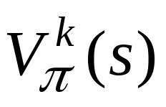
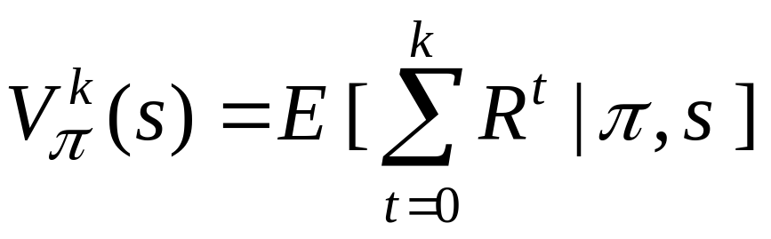
Finite Horizon Problems
Utility (value) depends on stage-to-go
  hence so should policy: nonstationary π(s,k)
is k-stage-to-go value function for π
Here R^{t} is a random variable denoting reward received at stage t.

Slide 22
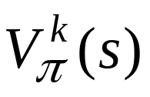
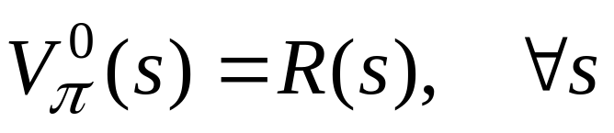
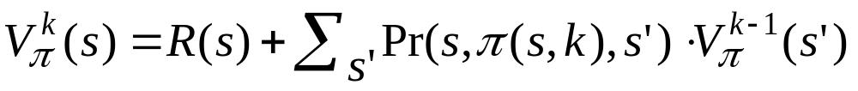
Successive Approximation
Successive approximation algorithm used to compute by dynamic programming
(a)
(b)
π(s,k)
0.7
0.3
V^{k}
V^{k-1}

Slide 23
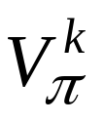
Successive Approximation
Let P^{π,k} be matrix constructed from rows of action chosen by policy
In matrix form:
V^{k} = R + P^{π,k} V^{k-1}
Notes:
  π requires T n-vectors for policy representation
  requires an n-vector for representation
  Markov property is critical in this formulation since value at s is defined independent of how s was reached

Slide 24
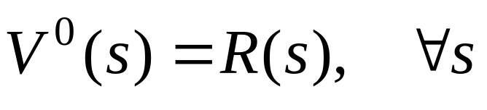
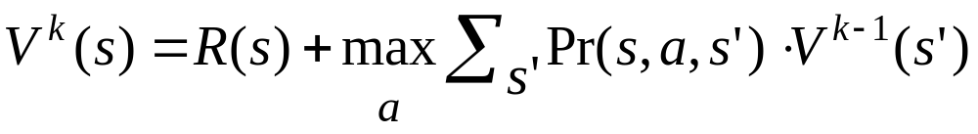
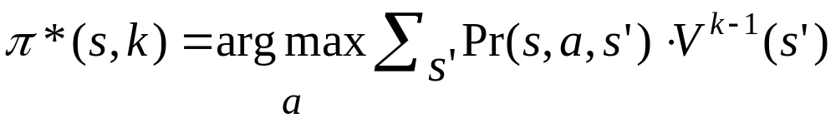
Value Iteration (Bellman 1957)
Markov property allows exploitation of DP principle for optimal policy construction
  no need to enumerate |A|^{Tn} possible policies
Value Iteration
Bellman backup
V^{k} is optimal k-stage-to-go value function

Slide 25
Value Iteration
V^{t-2}
V^{t-1}
V^{t}
V^{t+1}
_{s1}
_{s2}
_{0.7}
_{0.7}
_{0.7}
_{0.4}
_{0.4}
_{0.4}
_{s3}
_{0.6}
_{0.6}
_{0.6}
_{0.3}
_{0.3}
_{0.3}
_{s4}
_{V}^{t}_{(s4) = R(s4)+max {}
_{0.7 V}^{t+1} _{(s1) + 0.3 V}^{t+1} _{(s4)}
_{0.4 V}^{t+1} _{(s2) + 0.6 V}^{t+1} _{(s3)}
}
Notes:
Mention time-dependence of value (independence in infinite horizon)

Slide 26
Value Iteration
V^{t-2}
V^{t-1}
V^{t}
V^{t+1}
_{s1}
_{s2}
_{0.7}
_{0.7}
_{0.7}
_{0.4}
_{0.4}
_{0.4}
_{s3}
_{0.6}
_{0.6}
_{0.6}
_{0.3}
_{0.3}
_{0.3}
_{s4}
_{Π}^{t}_{(s4) = max { }}

Slide 27
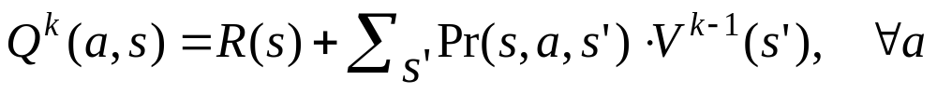
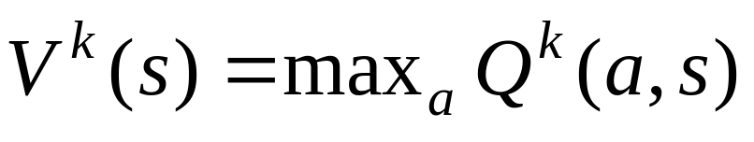
Value Iteration
Note how DP is used
  optimal soln to k-1 stage problem can be used without modification as part of optimal soln to k-stage problem
Because of finite horizon, policy nonstationary
In practice, Bellman backup computed using:

Slide 28
Complexity
T iterations
At each iteration |A| computations of n x n matrix times n-vector: O(|A|n³)
Total O(T|A|n³)
Can exploit sparsity of matrix: O(T|A|n²)

Slide 29
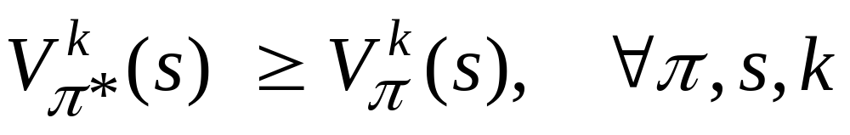
Summary
Resulting policy is optimal
  convince yourself of this; convince that nonMarkovian, randomized policies not necessary
Note: optimal value function is unique, but optimal policy is not

Slide 30
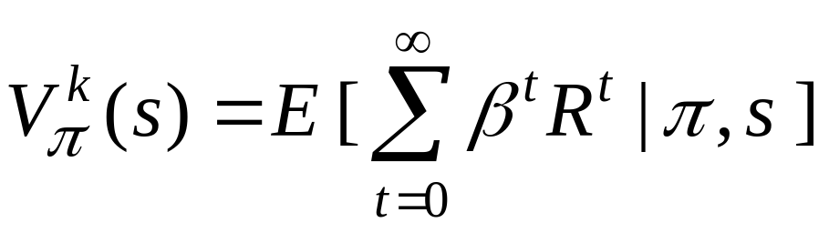
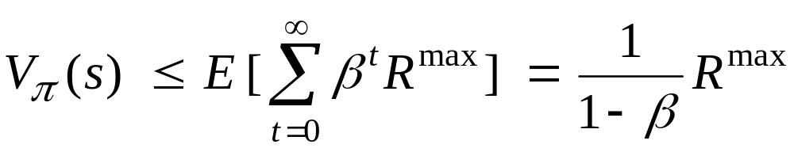
Discounted Infinite Horizon MDPs
Total reward problematic (usually)
  many or all policies have infinite expected reward
  some MDPs (e.g., zero-cost absorbing states) OK
“Trick”: introduce discount factor 0 ≤ β < 1
  future rewards discounted by β per time step
Note:
Motivation: economic? failure prob? convenience?

Slide 31
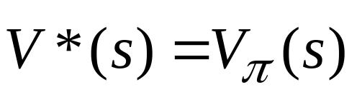
Some Notes
Optimal policy maximizes value at each state
Optimal policies guaranteed to exist (Howard60)
Can restrict attention to stationary policies
  why change action at state s at new time t?
We define for some optimal π

Slide 32
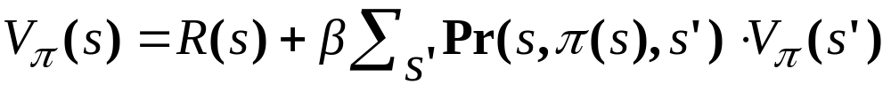
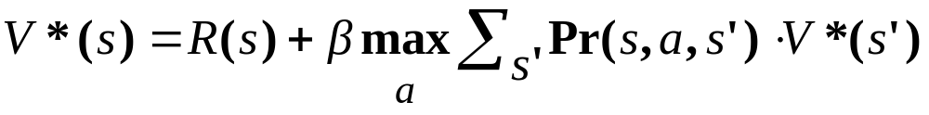
Value Equations (Howard 1960)
Value equation for fixed policy value
Bellman equation for optimal value function

Slide 33
Backup Operators
We can think of the fixed policy equation and the Bellman equation as operators in a vector space
  e.g., Lª(V) = V’ = R + βPªV
  V_{π} is unique fixed point of policy backup operator L_{π}
  V* is unique fixed point of Bellman backup L*
We can compute V_{π} easily: policy evaluation
  simple linear system with n variables, n constraints
  solve V = R + βPV
Cannot do this for optimal policy
  max operator makes things nonlinear

Slide 34
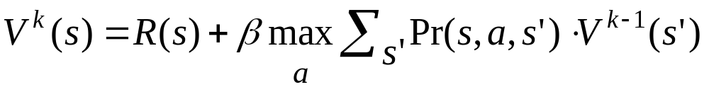
Value Iteration
Can compute optimal policy using value iteration, just like FH problems (just include discount term)
  no need to store argmax at each stage (stationary)

Slide 35
Convergence
L(V) is a contraction mapping in R^{n}
  || LV – LV’ || ≤ β || V – V’ ||
When to stop value iteration? when ||V^{k} - V^{k-1}||≤ ε
  ||V^{k+1} - V^{k}|| ≤ β ||V^{k} - V^{k-1}||
  this ensures ||V^{k} – V*|| ≤ εβ /1-β
Convergence is assured
  any guess V: || V* - L*V || = ||L*V* - L*V || ≤ β|| V* - V ||
  so fixed point theorems ensure convergence

Slide 36
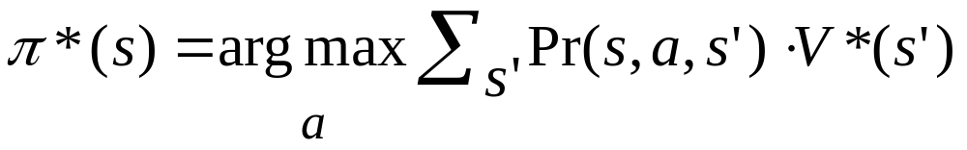
How to Act
Given V* (or approximation), use greedy policy:
  if V within ε of V*, then V(π) within 2ε of V*
There exists an ε s.t. optimal policy is returned
  even if value estimate is off, greedy policy is optimal
  proving you are optimal can be difficult (methods like action elimination can be used)

Slide 37
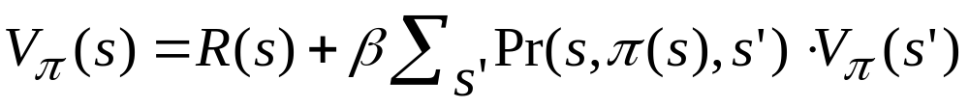
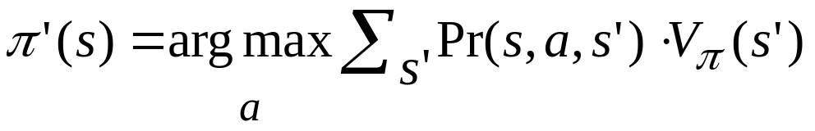
Policy Iteration
Given fixed policy, can compute its value exactly:
Policy iteration exploits this
1. Choose a random policy π
2. Loop:
(a) Evaluate V_{π}
(b) For each s in S, set
(c) Replace π with π’
Until no improving action possible at any state

Slide 38
Policy Iteration Notes
Convergence assured (Howard)
  intuitively: no local maxima in value space, and each policy must improve value; since finite number of policies, will converge to optimal policy
Very flexible algorithm
  need only improve policy at one state (not each state)
Gives exact value of optimal policy
Generally converges much faster than VI
  each iteration more complex, but fewer iterations
  quadratic rather than linear rate of convergence

Slide 39
Modified Policy Iteration
MPI a flexible alternative to VI and PI
Run PI, but don’t solve linear system to evaluate policy; instead do several iterations of successive approximation to evaluate policy
You can run SA until near convergence
  but in practice, you often only need a few backups to get estimate of V(π) to allow improvement in π
  quite efficient in practice
  choosing number of SA steps a practical issue

Slide 40
Asynchronous Value Iteration
Needn’t do full backups of VF when running VI
Gauss-Siedel: Start with V^{k} .Once you compute V^{k+1}(s), you replace V^{k}(s) before proceeding to the next state (assume some ordering of states)
  tends to converge much more quickly
  note: V^{k} no longer k-stage-to-go VF
AVI: set some V⁰; Choose random state s and do a Bellman backup at that state alone to produce V¹; Choose random state s…
  if each state backed up frequently enough, convergence assured
  useful for online algorithms (reinforcement learning)

Slide 41
Some Remarks on Search Trees
Analogy of Value Iteration to decision trees
  decision tree (expectimax search) is really value iteration with computation focussed on reachable states
Real-time Dynamic Programming (RTDP)
  simply real-time search applied to MDPs
  can exploit heuristic estimates of value function
  can bound search depth using discount factor
  can cache/learn values
  can use pruning techniques

Slide 42
Logical or Feature-based Problems
AI problems are most naturally viewed in terms of logical propositions, random variables, objects and relations, etc. (logical, feature-based)
E.g., consider “natural” spec. of robot example
  propositional variables: robot’s location, Craig wants coffee, tidiness of lab, etc.
  could easily define things in first-order terms as well
|S| exponential in number of logical variables
  Spec./Rep’n of problem in state form impractical
  Explicit state-based DP impractical
  Bellman’s curse of dimensionality

Slide 43
Solution?
Require structured representations
  exploit regularities in probabilities, rewards
  exploit logical relationships among variables
Require structured computation
  exploit regularities in policies, value functions
  can aid in approximation (anytime computation)
We start with propositional represnt’ns of MDPs
  probabilistic STRIPS
  dynamic Bayesian networks
  BDDs/ADDs

Slide 44
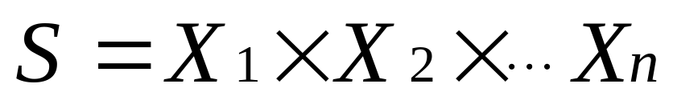
Propositional Representations
States decomposable into state variables
Structured representations the norm in AI
  STRIPS, Sit-Calc., Bayesian networks, etc.
  Describe how actions affect/depend on features
  Natural, concise, can be exploited computationally
Same ideas can be used for MDPs

Slide 45
Robot Domain as Propositional MDP
Propositional variables for single user version
  Loc (robot’s locat’n): Off, Hall, MailR, Lab, CoffeeR
  T (lab is tidy): boolean
  CR (coffee request outstanding): boolean
  RHC (robot holding coffee): boolean
  RHM (robot holding mail): boolean
  M (mail waiting for pickup): boolean
Actions/Events
  move to an adjacent location, pickup mail, get coffee, deliver mail, deliver coffee, tidy lab
  mail arrival, coffee request issued, lab gets messy
Rewards
  rewarded for tidy lab, satisfying a coffee request, delivering mail
  (or penalized for their negation)

Slide 46
State Space
State of MDP: assignment to these six variables
  160 states
  grows exponentially with number of variables
Transition matrices
  25600 (or 25440) parameters required per matrix
  one matrix per action (6 or 7 or more actions)
Reward function
  160 reward values needed
Factored state and action descriptions will break this exponential dependence (generally)

Slide 47
Dynamic Bayesian Networks (DBNs)
Bayesian networks (BNs) a common representation for probability distributions
  A graph (DAG) represents conditional independence
  Tables (CPTs) quantify local probability distributions
Recall Pr(s,a,-) a distribution over S (X₁ x ... x X_{n})
  BNs can be used to represent this too
Before discussing dynamic BNs (DBNs), we’ll have a brief excursion into Bayesian networks

Slide 48
Bayes Nets
In general, joint distribution P over set of variables (X₁ x ... x X_{n}) requires exponential space for representation inference
BNs provide a graphical representation of conditional independence relations in P
  usually quite compact
  requires assessment of fewer parameters, those being quite natural (e.g., causal)
  efficient (usually) inference: query answering and belief update

Slide 49
Extreme Independence
If X₁, X₂,... X_{n} are mutually independent, then
P(X₁, X₂,... X_{n} ) = P(X₁)P(X₂)... P(X_{n})
Joint can be specified with n parameters
  cf. the usual 2^{n}-1 parameters required
Though such extreme independence is unusual, some conditional independence is common in most domains.
BNs exploit this conditional independence.

Slide 50
An Example Bayes Net
Pr(B=t) Pr(B=f)
0.05 0.95
Earthquake
Burglary
Pr(A|E,B)
e,b 0.9 (0.1)
e,b 0.2 (0.8)
e,b 0.85 (0.15)
e,b 0.01 (0.99)
Alarm
Nbr1Calls
Nbr2Calls

Slide 51
Earthquake Example (con’t)
If I know whether Alarm, no other evidence influences my degree of belief in Nbr1Calls
  P(N1|N2,A,E,B) = P(N1|A)
  also: P(N2|N2,A,E,B) = P(N2|A) and P(E|B) = P(E)
By the chain rule we have
  P(N1,N2,A,E,B) = P(N1|N2,A,E,B) ·P(N2|A,E,B)·
  P(A|E,B) ·P(E|B) ·P(B)
  = P(N1|A) ·P(N2|A) ·P(A|B,E) ·P(E) ·P(B)
Full joint requires only 10 parameters (cf. 32)

Slide 52
BNs: Qualitative Structure
Graphical structure of BN reflects conditional independence among variables.
Each variable X is a node in the DAG.
Edges denote direct probabilistic influence
  usually interpreted causally
  parents of X are denoted Par(X)
X is conditionally independent of all nondescendents given its parents
  Graphical test exists for more general independence

Slide 53
BNs: Quantification
To complete specification of joint, quantify BN
For each variable X, specify CPT: P(X | Par(X))
  number of params locally exponential in |Par(X)|
If X₁, X₂,... X_{n} is any topological sort of the network, then we are assured:
P(X_{n},X_{n-1},...X₁) = P(X_{n}| X_{n-1},...X₁)·P(X_{n-1} | X_{n-2},… X₁)
… P(X₂ | X₁) · P(X₁)
= P(X_{n}| Par(X_{n})) · P(X_{n-1} | Par(X_{n-1})) … P(X₁)

Slide 54
Inference in BNs
The graphical independence representation gives rise to efficient inference schemes.
We generally want to compute Pr(X) or Pr(X|E) where E is (conjunctive) evidence.
Computations organized network topology
One simple algorithm: variable elimination (VE)

Slide 55
Variable Elimination
A factor is a function from some set of variables into a specific value: e.g., f(E,A,N1)
  CPTs are factors, e.g., P(A|E,B) function of A,E,B
VE works by eliminating all variables in turn until there is a factor with only query variable.
To eliminate a variable:
  join all factors containing that variable (like DB)
  sum out the influence of the variable on new factor
  exploits product form of joint distribution

Slide 56
Example of VE: P(N1)
Earthqk
Burgl
P(N1)
= Σ_{N2,A,B,E} P(N1,N2,A,B,E)
= Σ_{N2,A,B,E} P(N1|A)P(N2|A) P(B)P(A|B,E)P(E)
= Σ_{A}P(N1|A) Σ_{N2}P(N2|A) Σ_{B}P(B) Σ_{E}P(A|B,E)P(E)
= Σ_{A}P(N1|A) Σ_{N2}P(N2|A) Σ_{B}P(B) f1(A,B)
= Σ_{A}P(N1|A) Σ_{N2}P(N2|A) f2(A)
= Σ_{A}P(N1|A) f3(A)
= f4(N1)
Alarm
N1
N2

Slide 57
Notes on VE
Each operation is a simply multiplication of factors and summing out a variable.
Complexity determined by size of largest factor
  e.g., in example, 3 vars (not 5)
  linear in number of vars, exponential in largest factor
  elimination ordering has great impact on factor size
  optimal elimination orderings: NP-hard
  heuristics, special structure (e.g., polytrees) exist
Practically, inference is much more tractable using structure of this sort.

Slide 58
Dynamic BNs
Dynamic Bayes net action representation
  one Bayes net for each action a, representing the set of conditional distributions Pr(S^{t+1}|A^{t},S^{t})
  each state variable occurs at time t and t+1
  dependence of t+1 variables on t variables and other t+1 variables provided (acyclic)
  no quantification of time t variables given (since we don’t care about prior over S^{t})

Slide 59
DBN Representation: DelC
RHMt
RHMt+1
^{RHM R(t+1) R(t+1)}
^{T 1.0 0.0}
^{F 0.0 1.0}
f_{RHM}(RHMt,RHMt+1)
Mt
Mt+1
^{T T(t+1) T(t+1)}
^{T 0.91 0.09}
^{F 0.0 1.0}
f_{T}(Tt,Tt+1)
Tt
Tt+1
^{L CR RHC CR(t+1) CR(t+1)}
^{O T T 0.2 0.8}
^{E T T 1.0 0.0}
^{O F T 0.0 1.0}
^{E F T 0.0 1.0}
^{O T F 1.0 0.1}
^{E T F 1.0 0.0}
^{O F F 0.0 1.0}
^{E F F 0.0 1.0}
Lt
Lt+1
CRt
CRt+1
RHCt
RHCt+1
f_{CR}(Lt,CRt,RHCt,CRt+1)

Slide 60
Benefits of DBN Representation
Pr(Rmt+1,Mt+1,Tt+1,Lt+1,Ct+1,Rct+1 | Rmt,Mt,Tt,Lt,Ct,Rct)
= f_{Rm}(Rmt,Rmt+1) * f_{M}(Mt,Mt+1) * f_{T}(Tt,Tt+1)
* f_{L}(Lt,Lt+1) * f_{Cr}(Lt,Crt,Rct,Crt+1) * f_{Rc}(Rct,Rct+1)
RHMt
RHMt+1
Mt
Mt+1
Only 48 parameters vs.
25440 for matrix
Removes global exponential
dependence
Tt
Tt+1
s₁ s_{2 ...} s₁₆₀
s₁ 0.9 0.05 ... 0.0
Lt
Lt+1
s₂ 0.0 0.20 ... 0.1
.
.
.
s₁₆₀ 0.1 0.0 ... 0.0
CRt
CRt+1
RHCt
RHCt+1

Slide 61
Structure in CPTs
Notice that there’s regularity in CPTs
  e.g., f_{Cr}(Lt,Crt,Rct,Crt+1) has many similar entries
  corresponds to context-specific independence in BNs
Compact function representations for CPTs can be used to great effect
  decision trees
  algebraic decision diagrams (ADDs/BDDs)
  Horn rules

Slide 62
Action Representation – DBN/ADD
Algebraic
Decision
Diagram
(ADD)
RHMt
RHMt+1
^{CR}
^{t}
Mt
Mt+1
^{RHC}
^{f}
^{t}
Tt
Tt+1
^{f}
^{L}
Lt
Lt+1
^{e}
º
^{CR(t+1)}
^{CR(t+1)}
^{CR(t+1)}
CRt
CRt+1
^{t}
^{f}
^{f}
^{t}
^{f}
^{t}
RHCt
RHCt+1
^{0.0}
^{1.0}
^{0.8}
^{0.2}
f_{CR}(Lt,CRt,RHCt,CRt+1)

Slide 63
Analogy to Probabilistic STRIPS
DBNs with structured CPTs (e.g., trees, rules) have much in common with PSTRIPS rep’n
  PSTRIPS: with each (stochastic) outcome for action associate an add/delete list describing that outcome
  with each such outcome, associate a probability
  treats each outcome as a “separate” STRIPS action
  if exponentially many outcomes (e.g., spray paint n parts), DBNs more compact
    simple extensions of PSTRIPS [BD94] can overcome this (independent effects)

Slide 64
Reward Representation
Rewards represented with ADDs in a similar fashion
  save on 2^{n} size of vector rep’n
^{JC}
^{CP}
^{CC}
^{JP}
^{BC}
^{JP}
¹⁰
⁰
¹²
⁹

Slide 65
Reward Representation
Rewards represented similarly
  save on 2^{n} size of vector rep’n
Additive independent reward also very common
  as in multiattribute utility theory
  offers more natural and concise representation for many types of problems
^{CC}
^{CT}
²⁰
⁰
+
^{CP}
¹⁰
⁰

Slide 66
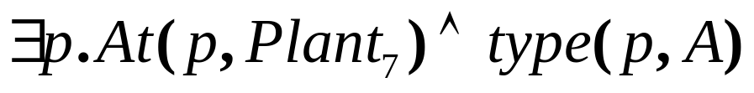
First-order Representations
First-order representations often desirable in many planning domains
  domains “naturally” expressed using objects, relations
  quantification allows more expressive power
Propositionalization is often possible; but...
  unnatural, loses structure, requires a finite domain
  number of ground literals grows dramatically with domain size
vs.

Slide 67
Situation Calculus: Language
Situation calculus is a sorted first-order language for reasoning about action.
Three basic ingredients:
  Actions: terms (e.g., load(b,t), drive(t,c₁,c₂))
  Situations: terms denoting sequence of actions
    built using function do: e.g., do(a₂, do(a₁, s))
    distinguished initial situation S₀
  Fluents: predicate symbols whose truth values vary
    last arg is situation term: e.g., On(b, t, s)
    functional fluents also: e.g., Weight(b, s)

Slide 68
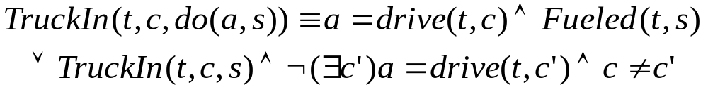
Situation Calculus: Domain Model
Domain axiomatization: successor state axioms
  one axiom per fluent F: F(x, do(a,s)) ≡ Φ_{F}(x,a,s)
These can be compiled from effect axioms
  use Reiter’s domain closure assumption

Slide 69
Situation Calculus: Domain Model
We also have:
  Action precondition axioms: Poss(A(x),s) ≡ Π_{A}(x,s)
  Unique names axioms
  Initial database describing S₀ (optional)

Slide 70
Axiomatizing Causal Laws in MDPs
Deterministic agent actions axiomatized as usual
Stochastic agent actions:
  broken into deterministic nature’s actions
  nature chooses det. action with specified probability
  nature’s actions axiomatized as usual
p
unloadSucc(b,t)
unload(b,t)
1-p
unloadFail(b,t)

Slide 71
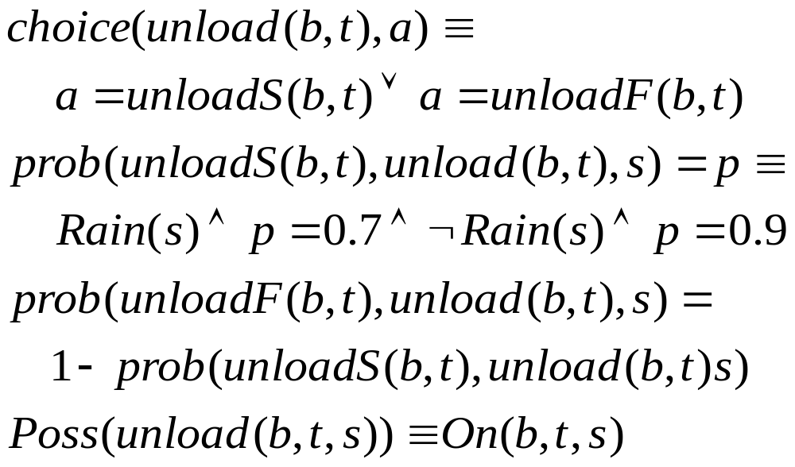
Axiomatizing Causal Laws

Slide 72
Axiomatizing Causal Laws
Successor state axioms involve only nature’s choices
  BIn(b,c,do(a,s)) = (∃t) [ TIn(t,c,s) ∧ a = unloadS(b,t)] ∨ BIn(b,c,s) ∧ ¬(∃t) a = loadS(b,t)

Slide 73
Stochastic Action Axioms
For each possible outcome o of stochastic action A(x), C_{o}(x) let denote a deterministic action.
Specify usual effect axioms for each C_{o}(x)
  these are deterministic, dictating precise outcome
For A(x), assert choice axiom
  states that the C_{o}(x) are only choices allowed by nature
Assert prob. axioms
  specifies prob. with which C_{o}(x) occurs in situation s
  can depend on properties of situation s
  must be well-formed (probs over the different outcomes sum to one in each feasible situation)

Slide 74
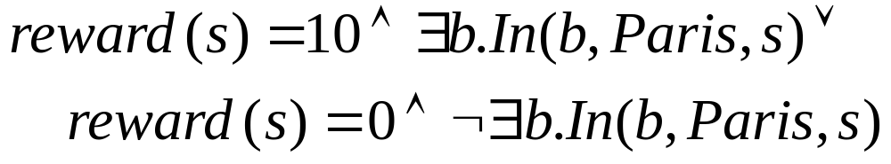
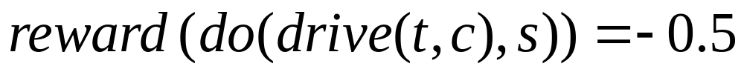
Specifying Objectives
Specify action and state rewards/costs

Slide 75
Advantages of SitCalc Rep’n
Allows natural use of objects, relations, quantification
  inherits semantics from FOL
Provides a reasonably compact representation
  not yet proposed, a method for capturing independence in action effects
Allows finite rep’n of infinite state MDPs
We’ll see how to exploit this

Slide 76
Structured Computation
Given compact representation, can we solve MDP without explicit state space enumeration?
Can we avoid O(|S|)-computations by exploiting regularities made explicit by propositional or first-order representations?
Two general schemes:
  abstraction/aggregation
  decomposition

Slide 77
State Space Abstraction
General method: state aggregation
  group states, treat aggregate as single state
  commonly used in OR [SchPutKin85, BertCast89]
  viewed as automata minimization [DeanGivan96]
Abstraction is a specific aggregation technique
  aggregate by ignoring details (features)
  ideally, focus on relevant features

Slide 78
Dimensions of Abstraction
^{Uniform}
^{Exact}
^{Adaptive}
^{A B C}
^{A B C}
^{A B C}
^{A B C}
^{5.3}
^{5.3}
^{5.3}
^{5.3}
^{2.9}
^{2.9}
^{A B C}
^{A B C}
^{A B C}
^{A B C}
^{9.3}
^{9.3}
^{Nonuniform}
^{Approximate}
^{Fixed}
^{A}
^{A}
^{A B}
^{5.3}
^{5.2}
^{5.5}
^{5.3}
^{2.9}
^{2.7}
⁼
^{B}
^{A B C}
^{C}
^{9.3}
^{9.0}
^{A B C}

Slide 79
Constructing Abstract MDPs
We’ll look at several ways to abstract an MDP
  methods will exploit the logical representation
Abstraction can be viewed as a form of automaton minimization
  general minimization schemes require state space enumeration
  we’ll exploit the logical structure of the domain (state, actions, rewards) to construct logical descriptions of abstract states, avoiding state enumeration

Slide 80
A Fixed, Uniform Approximate Abstraction Method
Uniformly delete features from domain [BD94/AIJ97]
Ignore features based on degree of relevance
  rep’n used to determine importance to sol’n quality
Allows tradeoff between abstract MDP size and solution quality
^{0.8}
^{0.5}
^{A B C}
^{A B C}
^{A B C}
^{A B C}
^{0.5}
^{0.2}
^{A B C}
^{A B C}

Slide 81
Immediately Relevant Variables
Rewards determined by particular variables
  impact on reward clear from STRIPS/ADD rep’n of R
  e.g., difference between CR/-CR states is 10, while difference between T/-T states is 3, MW/-MW is 5
Approximate MDP: focus on “important” goals
  e.g., we might only plan for CR
  we call CR an immediately relevant variable (IR)
  generally, IR-set is a subset of reward variables

Slide 82
Relevant Variables
We want to control the IR variables
  must know which actions influence these and under what conditions
A variable is relevant if it is the parent in the DBN for some action a of some relevant variable
  ground (fixed pt) definition by making IR vars relevant
  analogous def’n for PSTRIPS
  e.g., CR (directly/indirectly) influenced by L, RHC, CR
Simple “backchaining” algorithm to contruct set
  linear in domain descr. size, number of relevant vars

Slide 83
Constructing an Abstract MDP
Simply delete all irrelevant atoms from domain
  state space S’: set of assts to relevant vars
  transitions: let Pr(s’,a,t’) = Σ_{t ∈ t’} Pr(s,a,t’) for any s∈s’
    construction ensures identical for all s∈s’
  reward: R(s’) = max {R(s): s∈s’} - min {R(s): s∈s’} / 2
    midpoint gives tight error bounds
Construction of DBN/PSTRIPS rep’n of MDP with these properties involves little more than simplifying action descriptions by deletion.

Slide 84
Example
Lt
Lt+1
Abstract MDP
  only 3 variables
  20 states instead of 160
  some actions become identical, so action space is simplified
  reward distinguishes only CR and –CR (but “averages” penalties for MW and –T)
CRt
CRt+1
RHCt
RHCt+1
DelC action
Aspect | Condt’n | Rew.
Coffee | CR | -14
 | -CR | -4
Reward

Slide 85
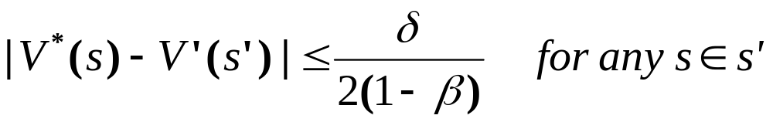
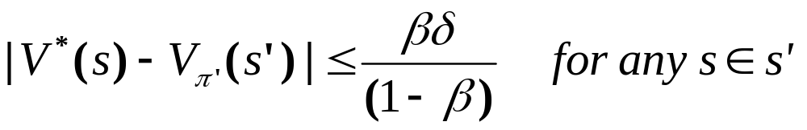
Solving Abstract MDP
Abstract MDP can be solved using std methods
Error bounds on policy quality derivable
  Let δ be max. reward span over abstract states
  Let V’ be optimal VF for M’, V* for original M
  Let π’ be optimal policy for M’ and π* for original M

Slide 86
FUA Abstraction: Relative Merits
FUA easily computed (fixed polynomial cost)
  can extend to adopt “approximate” relevance
FUA prioritizes objectives nicely
  a priori error bounds computable (anytime tradeoffs)
  can refine online (heuristic search) or use abstract VFs to seed VI/PI hierarchically [DeaBou97]
  can be used to decompose MDPs
FUA is inflexible
  can’t capture conditional relevance
  approximate (may want exact solution)
  can’t be adjusted during computation
  may ignore the only achievable objectives
Notes:
AT THE END:
This last point is especially important. Imagine that our robot decides to ignore
the Wet variable and tries to discover a policy that will obtain Coffee. It may be that the best Coffee-getting policy has very low expected utility (maybe it simply doesn’t have the ability to get coffee at all!) Now it produces a policy that takes it outside in the rain… this was the one objective it actually HAD in its control and it has chosen to ignore it. Our robot doesn’t know enough to stay in out of the rain.
Keep this in mind when we get to decomposition methods.

Slide 87
References
M. L. Puterman, Markov Decision Processes: Discrete Stochastic Dynamic Programming, Wiley, 1994.
D. P. Bertsekas, Dynamic Programming: Deterministic and Stochastic Models, Prentice-Hall, 1987.
R. Bellman, Dynamic Programming, Princeton, 1957.
R. Howard, Dynamic Programming and Markov Processes, MIT Press, 1960.
C. Boutilier, T. Dean, S. Hanks, Decision Theoretic Planning: Structural Assumptions and Computational Leverage, Journal of Artif. Intelligence Research 11:1-94, 1999.
A. Barto, S. Bradke, S. Singh, Learning to Act using Real-Time Dynamic Programming, Artif. Intelligence 72(1-2):81-138, 1995.

Slide 88
References (con’t)
R. Dearden, C. Boutilier, Abstraction and Approximate Decision Theoretic Planning, Artif. Intelligence 89:219-283, 1997.
T. Dean, K. Kanazawa, A Model for Reasoning about Persistence and Causation, Comp. Intelligence 5(3):142-150, 1989.
S. Hanks, D. McDermott, Modeling a Dynamic and Uncertain World I: Symbolic and Probabilistic Reasoning about Change, Artif. Intelligence 66(1):1-55, 1994.
R. Bahar, et al., Algebraic Decision Diagrams and their Applications, Int’l Conf. on CAD, pp.188-181, 1993.
C. Boutilier, R. Dearden, M. Goldszmidt, Stochastic Dynamic Programming with Factored Representations, Artif. Intelligence 121:49-107, 2000.

Slide 89
References (con’t)
J. Hoey, et al., SPUDD: Stochastic Planning using Decision Diagrams, Conf. on Uncertainty in AI, Stockholm, pp.279-288, 1999.
C. Boutilier, R. Reiter, M. Soutchanski, S. Thrun, Decision-Theoretic, High-level Agent Programming in the Situation Calculus, AAAI-00, Austin, pp.355-362, 2000.
R. Reiter. Knowledge in Action: Logical Foundations for Describing and Implementing Dynamical Systems, MIT Press, 2001.

